Slide 1
Intro to C# Language
CEC-101
1
CHERRY A. COLLERA

Slide 2

Identify the different objects in the picture.
Are you an object-oriented programmer?
Notes:
For example, below is a candid photograph of my good friend Maryo during one of his infamous journeys through the wilderness.
Right away we can list some of the different objects in the picture:
Maryo
Tree
Monster
Block
One way to model this world is to create a class for each of these objects, and we can use our imaginations to identify some of the properties and attributes the objects might have.
For example, perhaps our Maryo object can 'talk', has position coordinates, and a state of being either 'alive' or 'dead':
class Maryo(object):
Our Tree object can 'grow', has position coordinates, and a state of being either 'alive' or 'dead':
And our monster object can 'eat', has position coordinates, and a state of being 'alive' or 'dead'.
So now we have a basic programatic model of our world. But, we have to note that many of our objects share similar properties and attributes, such as position coordinates, state, and the unfortunate ability to 'poof'. Perhaps our model would benefit from simplicity if our objects inherited these properties and attributes from a base character model:

Slide 3
Object Oriented Programming (OOP)
a programming methodology that uses "objects” as the foundational concept
objects
- data structures consisting of data fields and methods together with their interactions
Notes:
Many modern programming languages now support OOP, at least as an option.
In programming, the term data structure refers to a scheme for organizing related pieces of information. The basic types of data structures include:
fileslists
arraysrecords
treestables
Each of these basic structures has many variations and allows different operations to be performed on the data.
A type of programming in which programmers define not only thedata type of a data structure, but also the types of operations (functions) that can be applied to the data structure. In this way, the data structure becomes an object that includes both data and functions. In addition, programmers can create relationships between one object and another. For example, objects caninheritcharacteristics from other objects.
One of the principal advantages of object-oriented programming techniques over procedural programming techniques is that they enable programmers to create modules that do not need to be changed when a new type of object is added. A programmer can simply create a new object that inherits many of its featuresfrom existing objects. This makes object-oriented programs easier to modify.

Slide 4
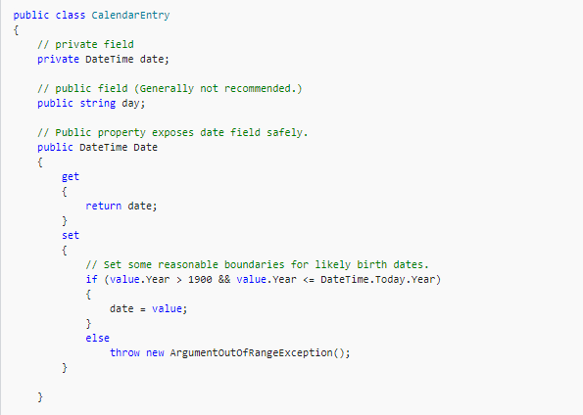
Data Fields
Notes:
Fields are declared In the class block by specifying the access level of the field, followed by the type of the field, followed by the name of the field.
A field is a variable of any type that is declared directly in a class or struct. Fields are members of their containing type.

Slide 5
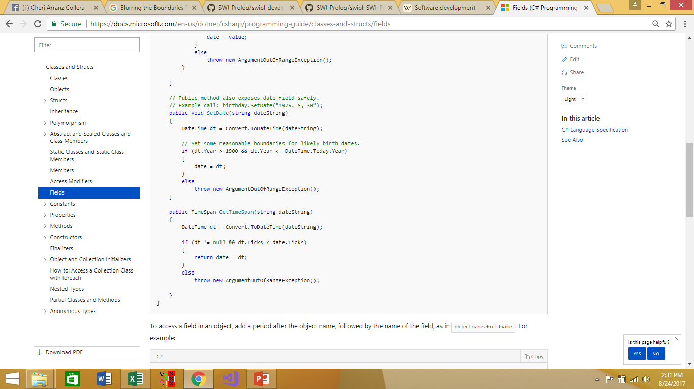
Methods
Notes:
A method is a code block that contains a series of statements. A program causes the statements to be executed by calling the method and specifying any required method arguments.

Slide 6
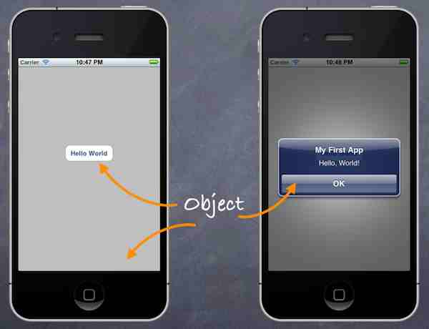
Why do we need object-oriented programming?
If you want to program just about anything these days, you’d better learn object-oriented programming
object-oriented programming to create mobile apps
Java, C# .NET, Visual Basic .NET,
Objective-C, Ruby, JavaScript,
jQuery, jQuery Mobile
Notes:
Today, just about every major software development methodology is based on objects. As a result, virtually all programming languages, scripting languages and application designs are object-oriented or object-based.
To back these statements up, all we have to do is take a quick look at the importance that objects play in mobile app development. This includes native apps for phones as well as hybrid apps that can be viewed on any browser (whether it is on a phone, PC, tablet, etc.).
While mobile apps are the hot topic today in the software industry, they are just the latest technology in its evolution.
Today, virtually all of the programming , scripting languages and frameworks used to create mobile applications rely on object technology: Java, C# .NET, Visual Basic .NET, Objective-C, Ruby, JavaScript, jQuery, jQuery Mobile, etc.
The Internet of Things” refers to uniquely identifiable objects. Thus, the next generation of object development may be the realm of smart cars and smart homes, which contain smart appliances.

Slide 7
Characteristics of OOPL
Class definitions
Objects
Abstraction
Encapsulation
Inheritance and class hierarchy
Polymorphism

Slide 8
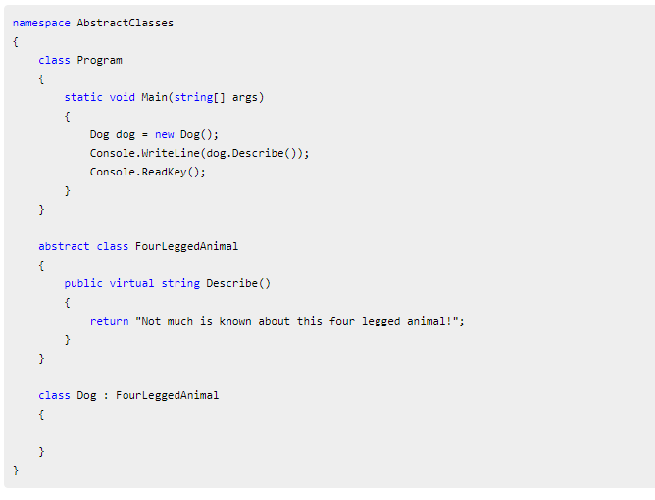
Class definitions, Objects, Abstraction
Notes:
Class definitions – Basic building blocks OOP and a single entity which has data and operations on data together
Objects – The instances of a class which are used in real functionality – its variables and operations
Abstraction – Specifying what to do but not how to do ; a flexible feature for having a overall view of an object’s functionality.

Slide 9
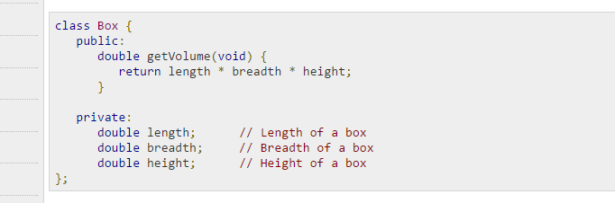
Encapsulation
Notes:
The variables length, breadth, and height are private. This means that they can be accessed only by other members of the Box class, and not by any other part of your program. This is one way encapsulation is achieved.
Encapsulation – Binding data and operations of data together in a single unit – A class adhere this feature

Slide 10
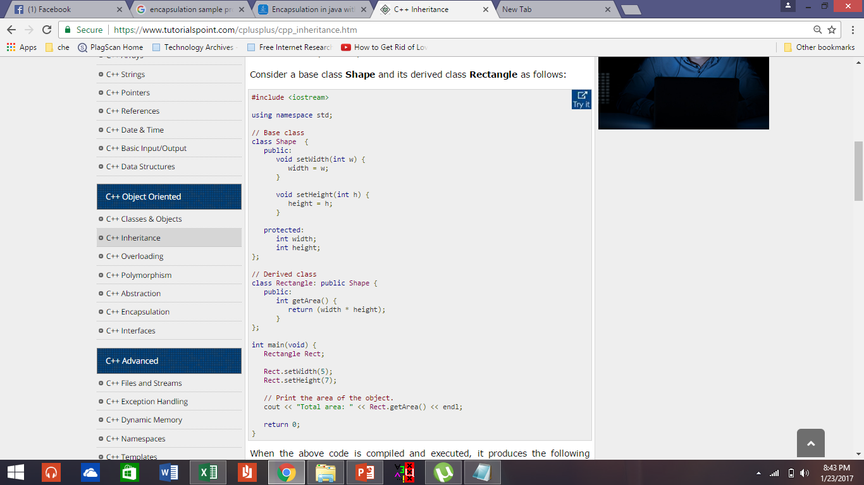
Inheritance
Notes:
A class can be derived from more than one classes, which means it can inherit data and functions from multiple base classes.
Inheritance and class hierarchy – Reusability and extension of existing classes

Slide 11
Polymorphism
Consider this operation:
add (a, multiply (b,c))
Using operator overloading permits a more concise way of writing it, like this:
a + b * c
Notes:
Polymorphism – Multiple definitions for a single name - functions with same name with different functionality; saves time in investing many function names Operator and Function overloading

Slide 12
Characteristics of OOPL
Generic classes
Class libraries
Message passing
Notes:
Generic classes – Class definitions for unspecified data. They are known as container classes. They are flexible and reusable.
Class libraries – Built-in language specific classes
Message passing – Objects communicates through invoking methods and sending data to them. This feature of sending and receiving information among objects through function parameters is known as Message Passing.

Slide 13
Different OOPLs
Java
C
C++
PHP
VB.net
Python
C#
JavaScript
Perl
Ruby

Slide 14
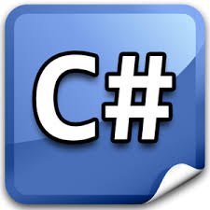
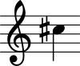
pronounced as see sharp

Slide 15
C#
one of many .NET programming languages
simple, modern, general-purpose, object-oriented programming language
evolution of the C and C++ family of languages
Notes:
object-oriented and allows you to build reusable components for a wide variety of application types
Developers often ask questions about why C# supports certain features or works in a certain way. The answer is often rooted in it's C++ heritage.
integrated development environment (IDE

Slide 16
C#
it borrows features from other programming languages, such as Delphi and Java
If you look at the most basic syntax of both C# and Java, the code looks very similar,
the code looks a lot like C++ too, which is intentional
Notes:
C# language is used to develop almost all types of software applications that come with Visual Studio IDE. If you are developing a dynamic web based application in ASP.NET, you will be required to code in C# or VB to write backend handling mechanism. If you are developing a Windows form application or a Windows Presentation Foundation (WPF) Application, you will be required to code in C#. Similarly, if you are developing a windows phone application, again you will be required to code in C#.

Slide 17

History
Microsoft within its .NET initiative
approved as a standard by Ecma (ECMA-334) and ISO (ISO/IEC 23270:2006)
C# is one of the programming languages designed for the Common Language Infrastructure (CLA)
development team is led by Anders Hejlsberg, principal designer and lead architect at Microsoft
Notes:
[17] Microsoft had considered keeping the name "Cool" as the final name of the language, but chose not to do so for trademark reasons. By the time the .NET project was publicly announced at the July 2000 Professional Developers Conference, the language had been renamed C#, and the class libraries and ASP.NET runtime had been ported to C#.
This International Standard specifies the form and establishes the interpretation of programs written in the C# programming language.
It specifies:The representation of C# programs;
The syntax and constraints of the C# language;
The semantic rules for interpreting C# programs;
The restrictions and limits imposed by a conforming implementation of C#.

Slide 18
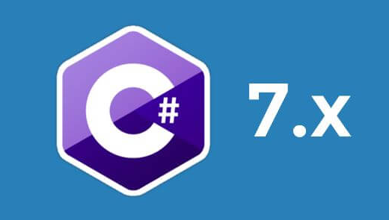
History
January 1999
new language called Cool, which stood for "C-like Object Oriented Language".
Microsoft introduced C# on June 26th, 2000 and it became a v1.0 product on Feb 13th 2002
Latest version?
Notes:
the most recent version is C#7.3 2018

Slide 19
History
Bill Joy, a co-founder of Sun Microsystems, the originator of Java, called C# an "imitation" of Java;
James Gosling, who created the Java said that C# is sort of Java
Klaus Kreft and Angelika Langer (authors of a C++ streams book) stated that "Java and C# are almost identical programming languages
Anders Hejlsberg said that C# is "not a Java clone" and is "much closer t+o C+" in its design

Slide 20
.NET
an environment in which programs run and was designed to be a new programming paradigm.
It is not an operating system, but rather a layer between the operating system and other applications.
Notes:
As such, it provides a platform for developing and running code that is easy to use. .NET is an integral part of many applications running on Windows and provides common functionality for those applications to run.
.NET supports development using a number of programming languages: Visual Basic, C#, C++, and a number of third-party languages. All the code from each of the languages can compile to the common Microsoft Intermediate Language (IL).

Slide 21
C# versus C and C++
/* A Hello World! program in C++. */
#include <iostream.h>
main()
{
cout << "Hello World!";
return 0;
}
/* A Hello World! program in C. */
#include<stdio.h>
main()
{
printf("Hello World");
}
C
C++
// A Hello World! program in C#.
using System;
namespace HelloWorld
{ class Hello
{ static void Main()
{ System.Console.WriteLine("Hello World!"); System.Console.ReadKey();
}
} }
C#

Slide 22
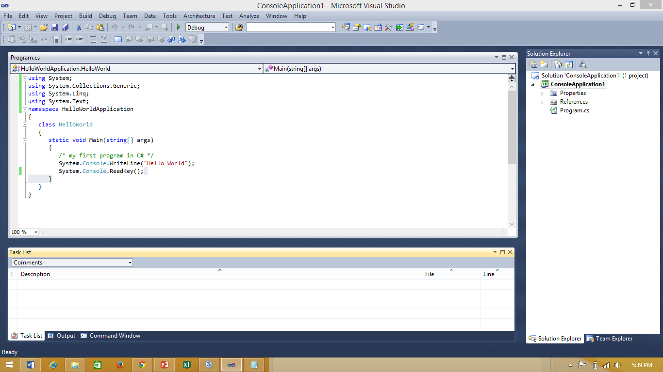
Visual Studio Integrated Development Environment (IDE)
1
2
3
menu bar
standard toolbar
text editor toolbar
editor
task list/output/command window
solution explorer/team explorer window
status line
4
6
5
7
Notes:
on the right hand side and you'll see the Solution Explorer. This is where all the files for your project are. (If you can't see the Solution Explorer, click View from the C# menu bar at the top. From the View menu, click Solution Explorer.)

Slide 23
Visual Studio Integrated Development Environment (IDE)
F5 – start debugging
PROGRAMMING EXAMPLE 1

Slide 24
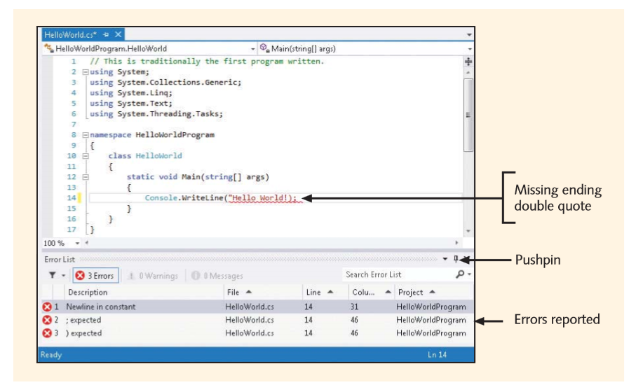
Error List Window
Notes:
The error messages are displayed in the Error List window found at the bottom of the IDE. The IDE also underlines the supposed location of the problem. You can also double-click on any of the error messages to go directly to the line flagged by the compiler. If the Error List tab is not visible on your screen, you can select Error List from the View menu.

Slide 25
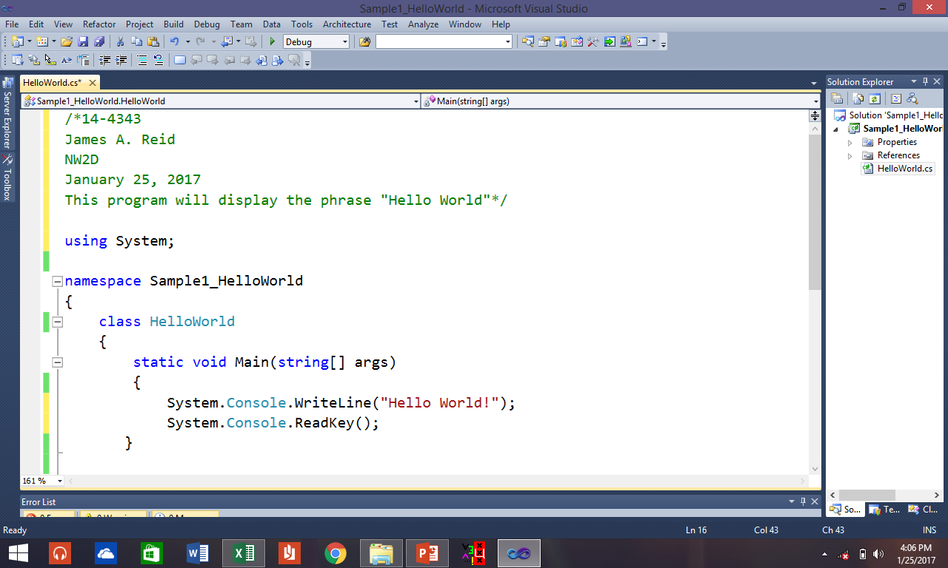
PROGRAMMING EXAMPLE 1: Sample1_HelloWorld

Slide 26
PROGRAMMING EXAMPLE 2: Sample2_MyProfile (Project Name) yourfullname.cs (source filename)
Create a program that will display your name, date of birth, course, year & section
Include multiline comments that will indicate student’s ID no, student’s full name, Section, Date, and the purpose of your program code

Slide 27
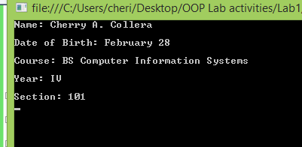
PROGRAMMING EXAMPLE 2: Output

Slide 28
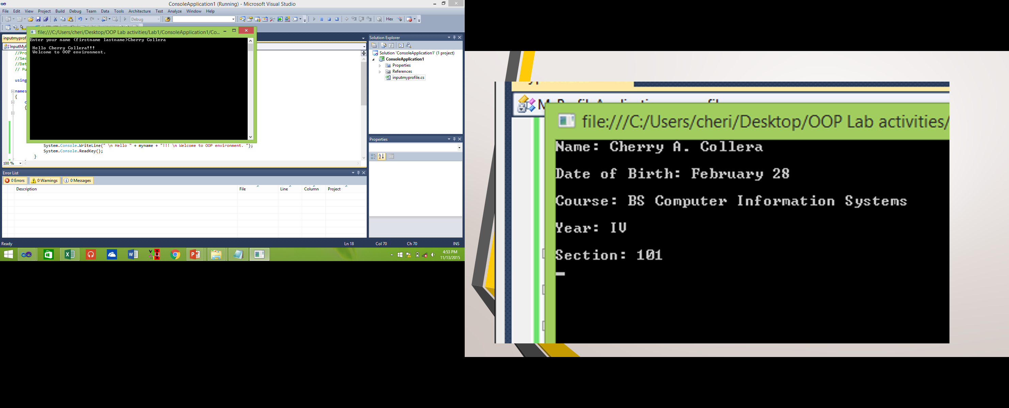
PROGRAMMING EXAMPLE 3: Sample3_InputMyName (Project Name) yourfullname.cs (source filename) Output

Slide 29
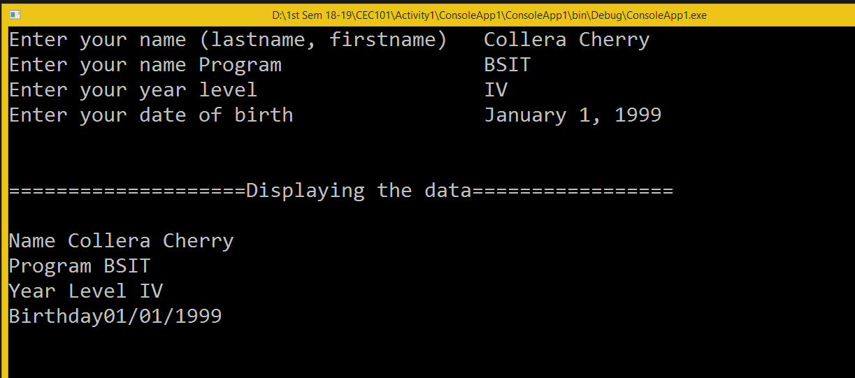
ConsoleApp1 Program.cs

Slide 30
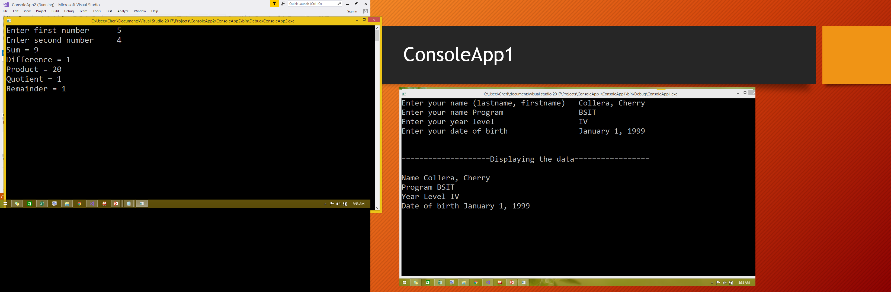
ConsoleApp2 Program.cs

Slide 31
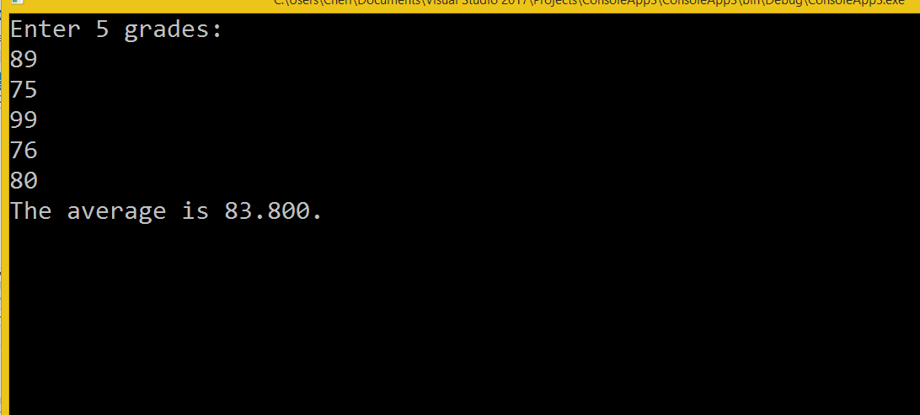
ConsoleApp3 Program.cs

